Slide 1
Visualizing Tree Map & Shape Map Using Microsoft Power BI
Presented by
Rajasekhar Siravati
44-599 Introduction to Data Visualization
04-13-2017

Slide 2
Outline
What is Tree map?
What is Shape map?
What is Microsoft Power BI?
Features of Microsoft Power BI
Goals
Demonstration
Lessons Learned

Slide 3
What is Tree map?
Tree map is an alternative way of visualizing the hierarchical structure
Represents data in the form of rectangles
The space inside each rectangle is allocated based on the quantitative value being measured
The rectangles arranged in size from top left (largest) to bottom right (smallest)

Slide 4
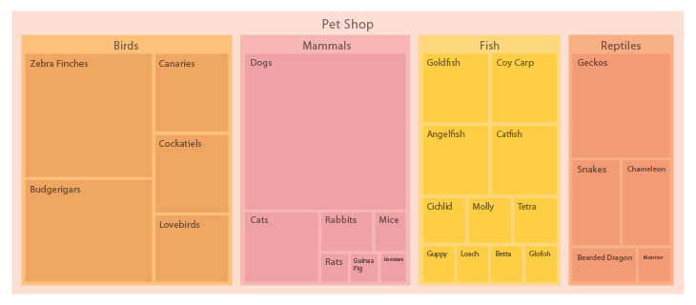
Example
Figure 1: Tree Map
http://www.datavizcatalogue.com/methods/treemap.html

Slide 5
What is Shape map?
Shape Map visual to show relative comparisons of regions
For example if you take USA Which has many regions, here we can compare the regions within the USA
Visualized by applying different colors to different regions (similar to Filled Map)
Shape Map allows you add your own custom map!
We have a feature in power BI
Statistical Research
Data Processing
Data Science
Machine Learning

Slide 6
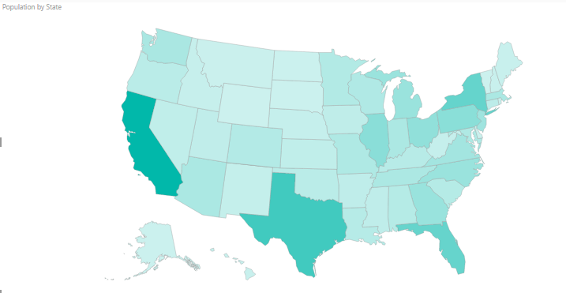
Example
Figure 2: Shape Map
http://www.enchantedlearning.com/usa/states/population.shtml

Slide 7
Advantages of Shape Map
In Shape map it is easy to view different regions or countries individually by selecting the appropriate country
It provides a feature to add your own map
It works with Topo JSON standard of geo location

Slide 8
Disadvantages of Shape Map
This visual is still in preview mode, and it lacks many features that can be available for map visuals
Drill down/up is not possible. You cannot add other layers to the map (for example if you want to add heat map, or bubbles to it)

Slide 9
What is Microsoft Power BI?
Power BI Desktop gives you tools to transform, analyze, and visualize data
Can access your data anywhere, anytime
It connects users to a broad range of data through easy-to-use dashboards, interactive reports, and compelling visualizations that bring data to life

Slide 10
Features of Microsoft Power BI
Visualize data, wherever it is
Excel spreadsheets, cloud services, streaming data
Be informed: always real time
If you signup updates are sent to your mail-id
Ask questions, get answers
If you own a dataset, you can add your own featured questions to that dataset

Slide 11
Advantages Microsoft Power BI
The pace of innovation is amazing. The product is updated about monthly
The free version reduces acquisition barriers
It is great for Excel users
The dashboard visualizations are best in class and continually updated from the community

Slide 12
Disadvantages Microsoft Power BI
It doesn’t handle large data sources well
It is pretty complex
It doesn’t have a solution for data quality
Microsoft Power BI assumes that the data you’re pulling has already been properly scrubbed and cleaned up

Slide 13
Goals
To visualize Tree map using the categories residential and Industrial from dataset
To Visualize Shape map using the category commercial from the dataset

Slide 14
Dataset
Year | State | Industry Sector | Residential | Commercial | Industrial | Total
2014 | AK | Total Electric Industry | 2043614 | 2761518 | 1359680 | 6164812
2014 | AL | Total Electric Industry | 32929598 | 22929309 | 34634820 | 90493727
2014 | AR | Total Electric Industry | 18441119 | 11988033 | 16650718 | 47080301
2014 | AZ | Total Electric Industry | 32346079 | 29289879 | 14661727 | 76297685
2014 | CA | Total Electric Industry | 89360680 | 119494062 | 52898430 | 262584786
2014 | CO | Total Electric Industry | 18092932 | 20129360 | 15110188 | 53396521
2014 | CT | Total Electric Industry | 12777579 | 12893531 | 3514798 | 29354460
2014 | DC | Total Electric Industry | 2072205 | 8548237 | 242149 | 11193589
2014 | DE | Total Electric Industry | 4644841 | 4197298 | 2496338 | 11338477
2014 | FL | Total Electric Industry | 116535263 | 92925670 | 16522425 | 226078111
2014 | GA | Total Electric Industry | 57167387 | 46608275 | 31849136 | 135789932
2014 | HI | Total Electric Industry | 2583770 | 3201898 | 3689784 | 9475452
2014 | IA | Total Electric Industry | 14426582 | 12339098 | 20436173 | 47201853
Total records = 51, Attributes = 7
Data source: https://www.eia.gov/electricity/data/state/sales_annual.xls

Slide 15

Demo

Slide 16
Lessons Learned
To find out the appropriate data for visualization
Learned how to filter and sort the data
Learned new custom shape map using power BI

Slide 17
Thank You

